Slide 1
Welcome to the Epi Parameter Community Webinar Series
Artificial Intelligence to Automate Evidence Surveillance: Application to the Epidemiological Parameter Pipeline
Monday 25 March 2024, 16:00 -17:00 CET

Slide 2
Meeting agenda
Timetable for TWG Meeting: 25th March 2024 16:00 – 17:00 CET
16:00 – 16:05 | Welcome and introduction – Patricia Ndumbi, WHO
16:05 – 16:15 | The role of AI in living systematic reviews and evidence surveillance – Lisa Waddel, PHAC
16:15 – 16:25 | Evolution of AI Technology and Advancements for the Identification and Screening of Literature – Emma Tomini, PHAC
16:25 – 16:35 | Systematic Review Automation for Airborne transmission model – Elias Sandner, CERN
16:35 – 16:45 | CliZod, compiling the evidence on the climate sensitivity of zoonotic diseases – Emilie Vallee, Massey University
15:45 – 15:55 | Questions and discussions – Moderated by Lisa Waddel and Patricia Ndumbi
15:55 – 16:00 | Closing remarks and next steps – Patricia Ndumbi, WHO
Notes:
Good afternoon, everyone and thank you for joining the call today.
My name is Patricia Ndumbi, I am an epidemiologist working in the Surveillance systems Department at WHO
And I have been leading the establishment and coordination of the epi parameter project and community.

Slide 3




Our presenters today…

Slide 4
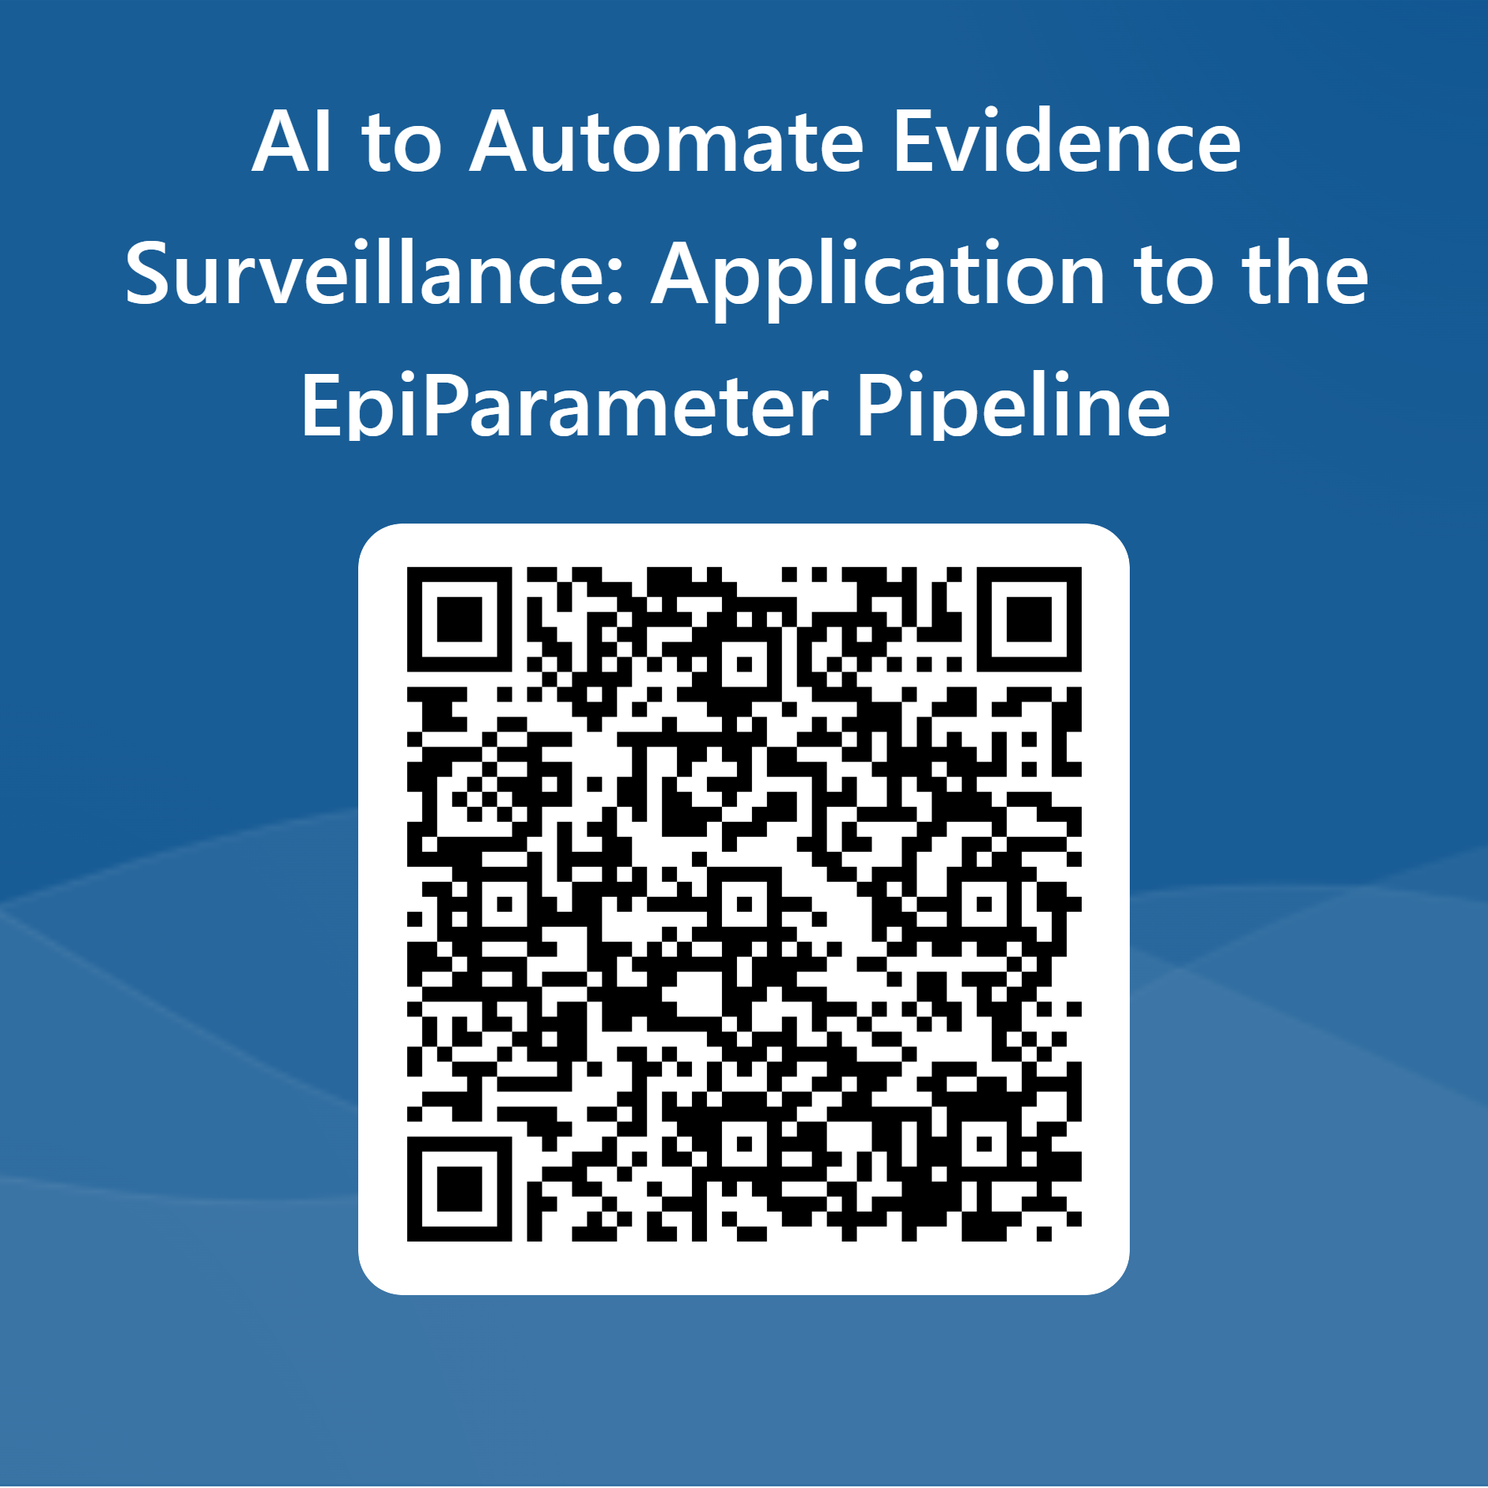
Quick Community Survey (will take 2 minutes!)
To let us know:
If you’d like to be added to the mailing list
If you’d like to actively contribute to a specific workstream
If you’d like to connect or collaborate with one of today’s presenters
If you’d like to present or know someone who would like to present at our webinar series

Slide 5






Global repository of epidemiological parameters – Collaborative approach
Expertise in evidence synthesis methodologies
AI tools for parameter extraction
Extraction of parameters for 9 priority diseases
{EpiReview} package
Prioritization of diseases and parameters
Extraction of parameters
Storage and use of parameters
Maintenance and validation of parameters
Scientific recognition and other incentives
Federated analytics
Analytical tools
{Epiparameter} package
Notes:
This is just an example of some of the initiatives we brought together:
ICL is working on the extraction of parameters from published literature. They have a plan to extract parameters for 9 priority diseases and I believe Anne’s presentation today will give more details on this.
PHAC is providing expertise in knowledge synthesis methodologies, and they recently started looking into the development of AI tools to automate the screening of articles.
Massey U is also exploring the development of AI tools but for one health parameters extraction
Global.h are exploring the use of federated analytics for real-time estimation of parameters from primary data.
And finally, Epiverse has developed analytical tools to enable the use of extracted parameters in analytical pipelines
So, as you can see, although this project is coordinated and catalysed by WHO it is really community-driven!
So, we invite you to reach out.. if you too would like to work on a piece of this exciting puzzle!

Slide 6
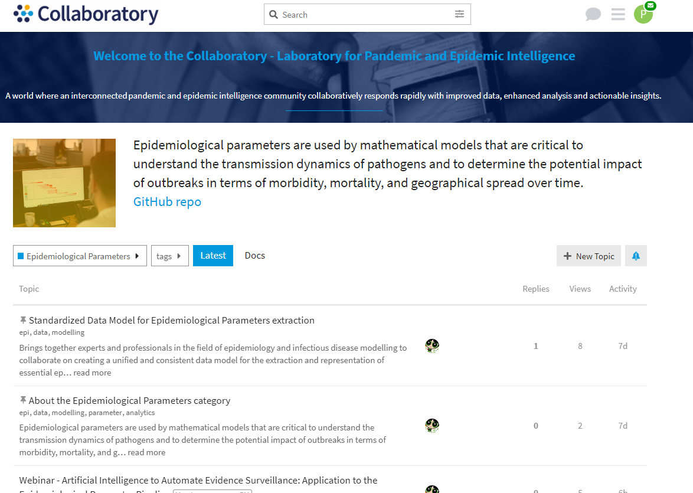
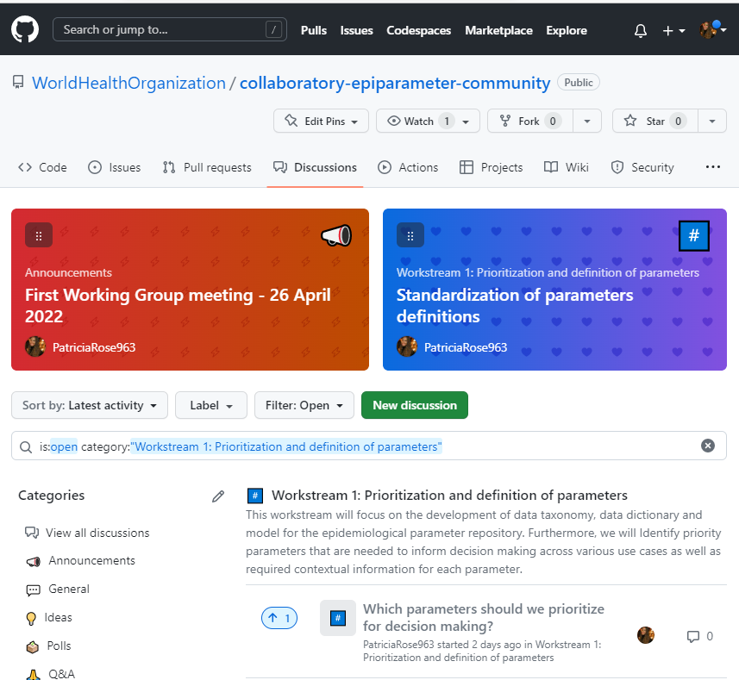
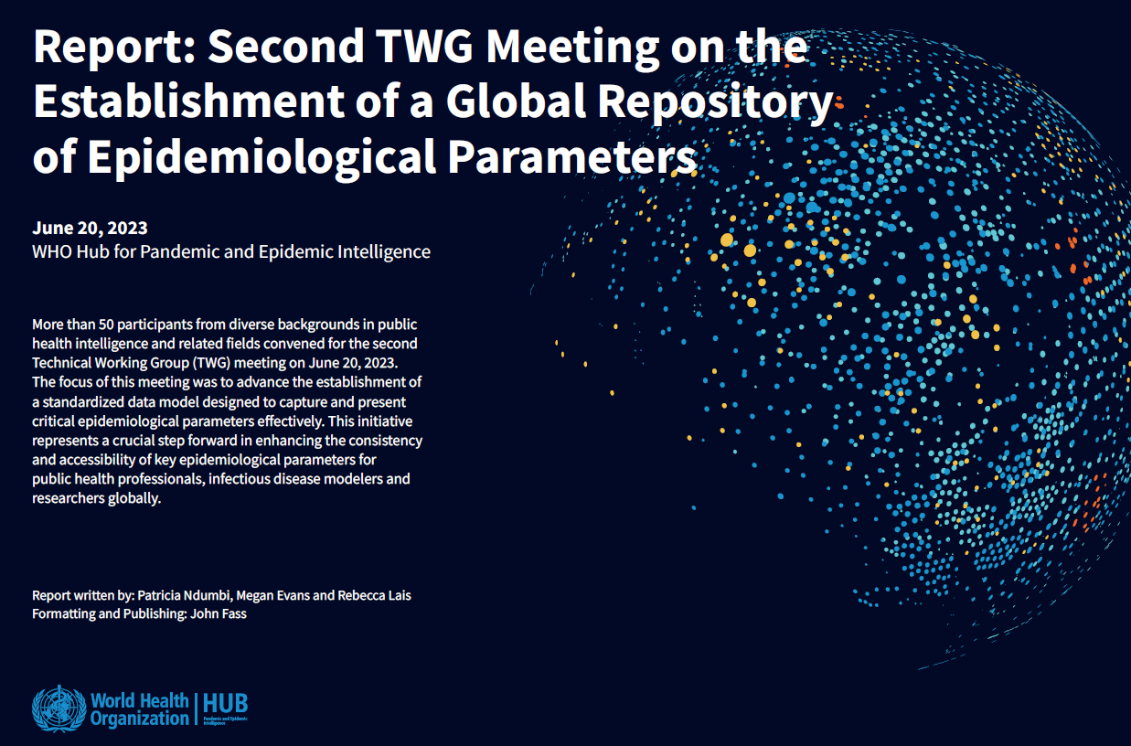
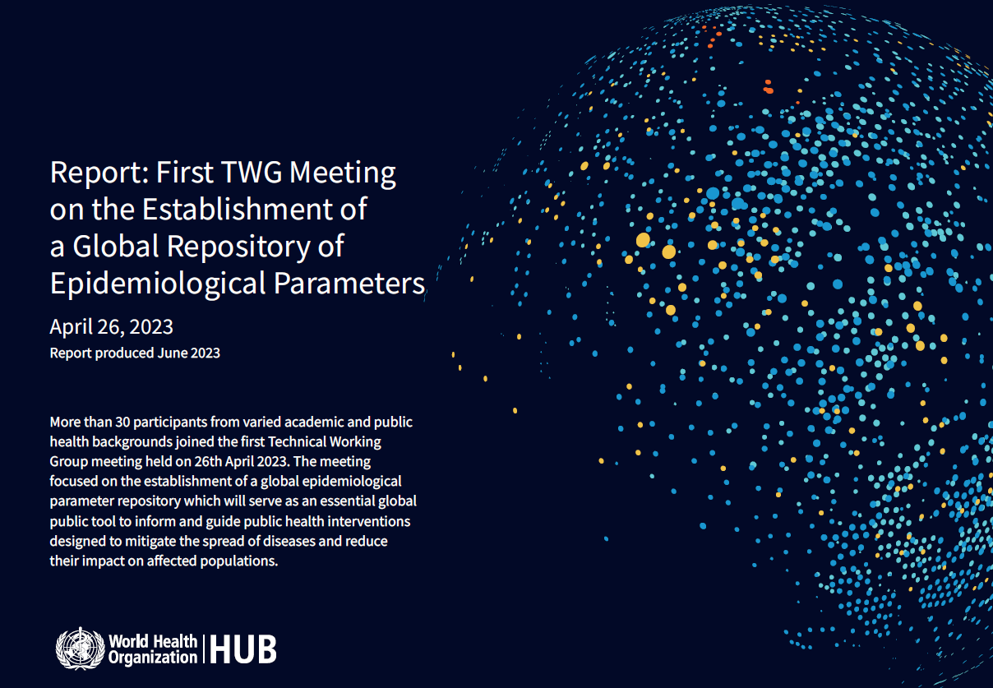
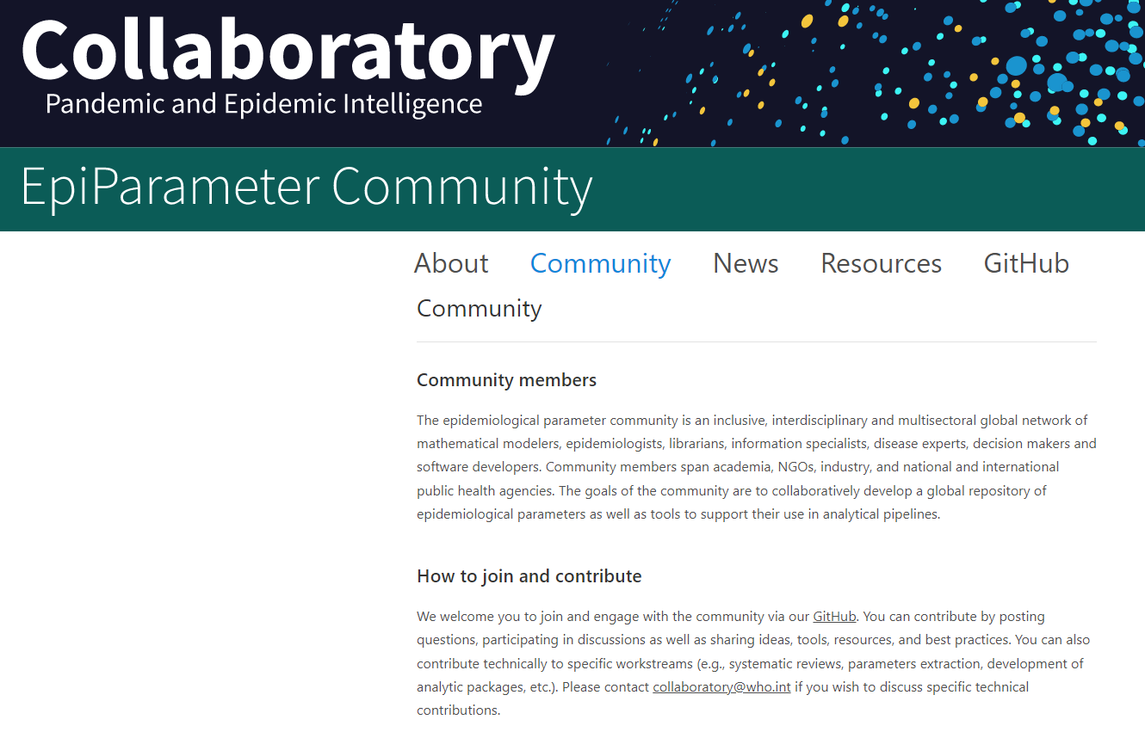
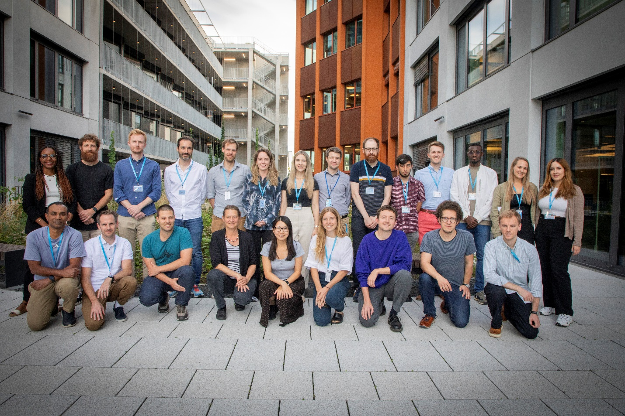
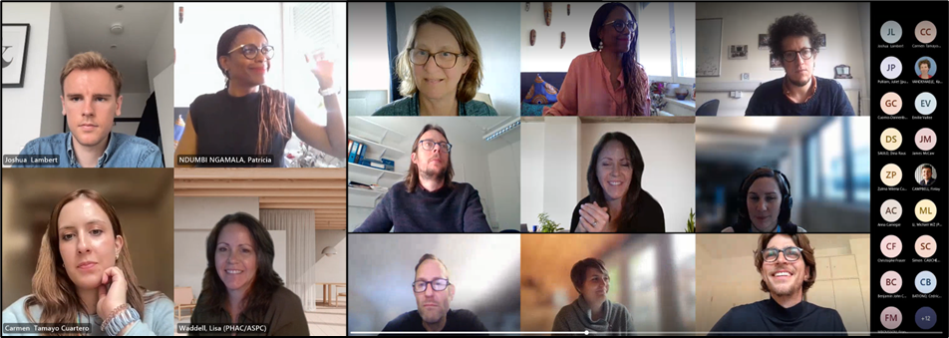
How to Join and Contribute to the WHO Epi parameter community
Discourse
GitHub
TWG meeting reports
Website
Outbreak analytics Hackathon
TWG virtual meetings

Slide 7
What is Next?
Next Monthly Webinar in April – topic and date TBD.
Workstream 2 specific working group on AI – to be coordinated by Lisa Waddell, PHAC.
In person Workshop on refining the GREP database schema – May 14-16, Berlin.

Slide 8
Thank you

Slide 9

What is Next?
EpiParameter Collaboratory Workshop: Refining the GREP database schema
In-person Hackathon on May 14-16th , Berlin.
Test Public Health use cases to inform /refine the database schema and structure
Identify challenges and solutions related to parameters extraction
Enhance interoperability between parameter data storage solutions and analytical tools
Notes:
There are various ways that you can join and contribute to this initiative
You can come-up with a project related to a workstream or join an existing project
You can join our community GitHub and website to keep up with events and discussion topics
You can attend our virtual meetings such as this one – and from now on we hope to organize Monthly meetings
And finally, you can also attend some of our in-person events
-----------------------------------------------------------------------------------------------------
Here are some concrete examples of approaches we used to build the community
We developed a governance framework, which really will be applied to all Collaboratory projects and could be helpful for other WSE project as well (I will circulate this for input next week)
This framework addressed topics such scientific recognition and data governance (I’d like to thank Isabel for helping me finalize this product)
We created a community website and github page to foster online community engagement
We also organized virtual and in-person meetings to discuss complex issues and jointly come up with solutions

Slide 10
Problem Statement and proposed approach
Problem Statement
There is currently no global repository of epidemiological parameters that the global modelling community can access, use, and contribute to.
Future State
A global repository of epidemiological parameters that is publicly accessible by modellers, epidemiologist, subject matter experts and decision makers to inform public health response.
1. Prioritization and definition of parameters
2. Extraction of parameters
3. Storage and use of parameters
4. Maintenance and validation of parameters
5. Scientific recognition and other incentives
Proposed approach (5 workstreams)
Notes:
So, as a quick refresher for those who are new to this community
Our aim is to establish of a global repository of epi parameters which will enable faster and more transparent insight generation at the beginning of… and during an outbreak.
In order to achieve this, we have identified five workstreams:
The first one will focus on defining key parameters and the required contextual data in order to develop a standardized core data schema and taxonomy for the repository.
The 2nd workstream will focus on the development of protocols, methodologies and tools for the extraction of parameters either through retrospective review of published estimates OR through live estimation of parameters from primary outbreak data.
The 3rd will focus on how we store, access and use these parameters in analytical pipelines
The 4th will explore sustainable mechanisms for the update, maintenance and quality assurance of the parameters database
Finally, the last workstream will identify frameworks for scientific recognition and contribution incentives.

Slide 11
Global repository of epidemiological parameters – Collaborative approach
Prioritization of diseases and parameters
Extraction of parameters
Storage and use of parameters
Maintenance and validation of parameters
Scientific recognition and other incentives
Notes:
Before starting this project, we conducted a landscape analysis of existing initiatives to understand existing progress and gaps in this space.
During this analysis we realized that several stakeholders were already working on a piece of the puzzle but did not have the capacity to complete the whole picture on their own.
So, we leveraged our WHO convening power to form a community of practice to work collaboratively on the different workstreams.

Slide 12
Key project outputs
Parameters prioritization and contextualization
Extraction of parameters
Storage and use of parameters
Maintenance and validation of parameters
Scientific recognition and other incentives
Standardized extraction Protocol
Parameters storage tool
Quality assurance framework
Framework for scientific recognition
Parameters database schema
Reporting guidance
Analytical tools
Joint Peer review publications
Standardized Line list format & MDS
ShinyApp for Parameter visualization
AI tools
Notes:
This slide just shows some of the key output we would like to generate from each of the workstreams
Our next meeting will focus on AI tools, but I’ll let Lisa speak to this at the end of the meeting today.
-------------------------------
With workstream 1 – we want to develop a standardized core data model for the repository
With workstream 2 – we want to develop….
With workstream 3 – We want to develop tools for storage, analysis and visualization
With workstream 4 – we’d like to develop a framework for quality assurance
And finally, in workstream 5 – we want to develop….
Next steps:
Concept note developed
Imperial extraction – 9 priority pathogens (starting with Marburg)
Alignment on data model
Development of front-end web app for extraction
Use of X-Mart as data base for storage
PHAC extraction
In terms of way forwards, these are the key outputs we expect to produce from this project.
A GitHub repo and community forum to facilitate collaborations and information sharing between community members
A documented standardized protocol for the extraction of epidemiological characters
A database of extracted parameters for initial prioritized diseases
A shinyApp that facilitates the visualization and comparison of parameters estimates (across pathogens for instance)
Tools that can support the use of parameters in analytic pipelines
Documented lessons learned from the pilot phase implementation
Next steps:
thanks to Javeriana, Epiverse/LSHTM and Imperial for sharing their respective data model and to Mia for compiling the three
We want to curate the data model with the input we received from the survey and from this group (initial data model
Explore more use cases – through a workshop
------------------------------------------------
Next steps:
Concept note developed
Imperial extraction – 9 priority pathogens (starting with Marburg)
Alignment on data model
Development of front-end web app for extraction
Use of X-Mart as data base for storage
PHAC extraction

Slide 13
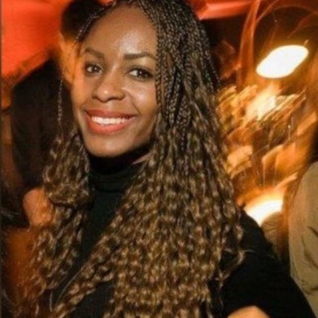

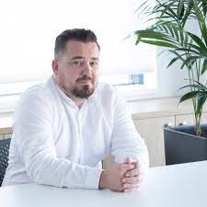
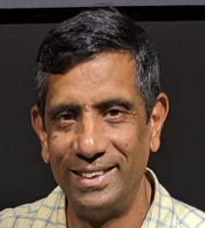
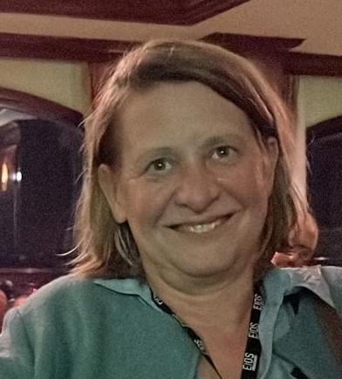
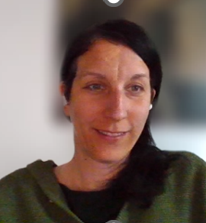
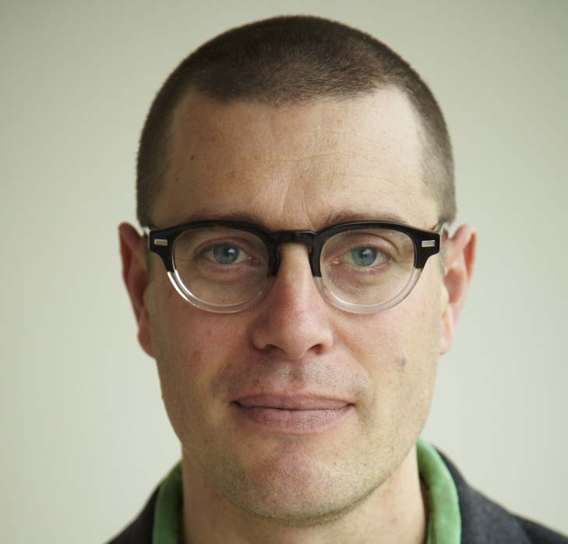
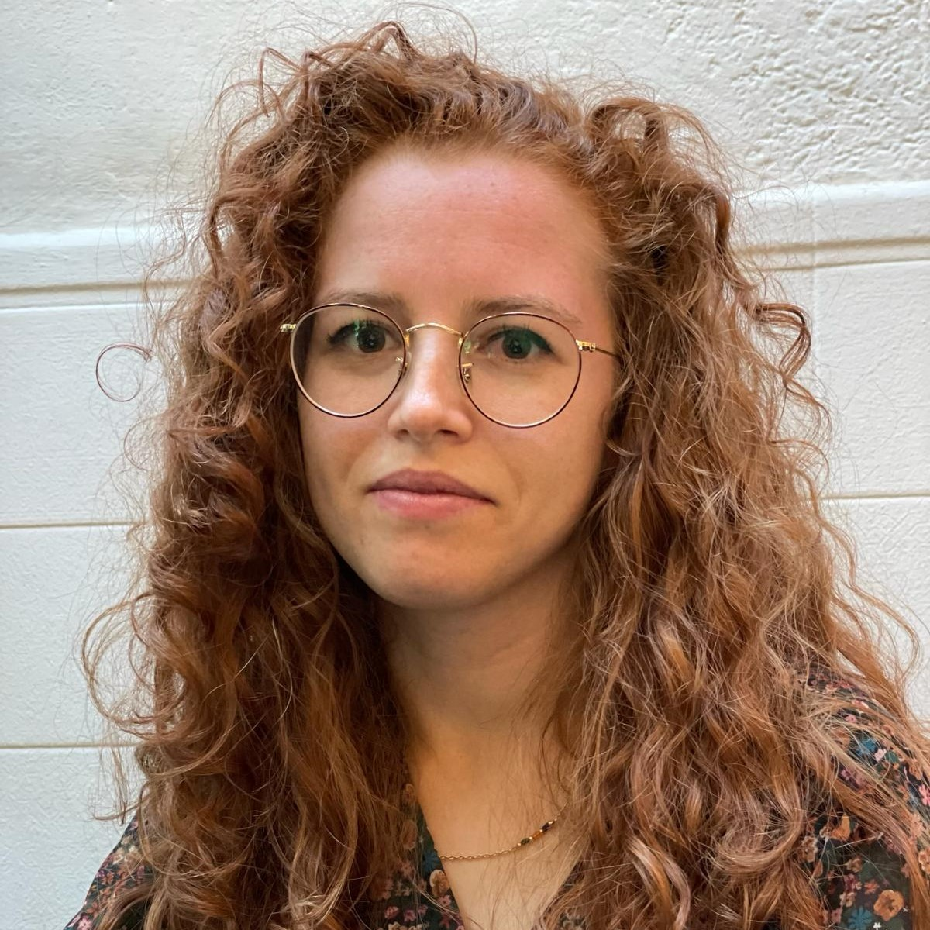
WHO Project Team
Patricia Ndumbi
Epidemiologist
Project Lead
Finlay Campbell
Modelling expert
Miroslav Levar
System architect
Paul Prabasaj
Modelling expert
Julia Fitzner
Collaboratory Team lead
Mia Zivkovic
Business Analyst
John Fass
UI/UIX expert
Elisa Di Maggio
Public Health specialist
Notes:
This is a quick overview of the WHO team who has been involved in this project.
And I’d like to welcome Prabasaj and Elisa who recently joined the team

Slide 14
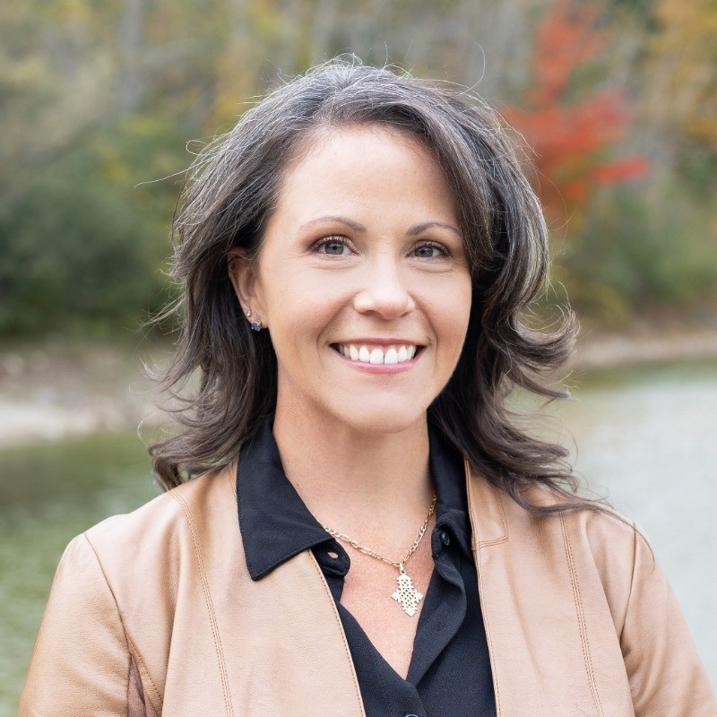
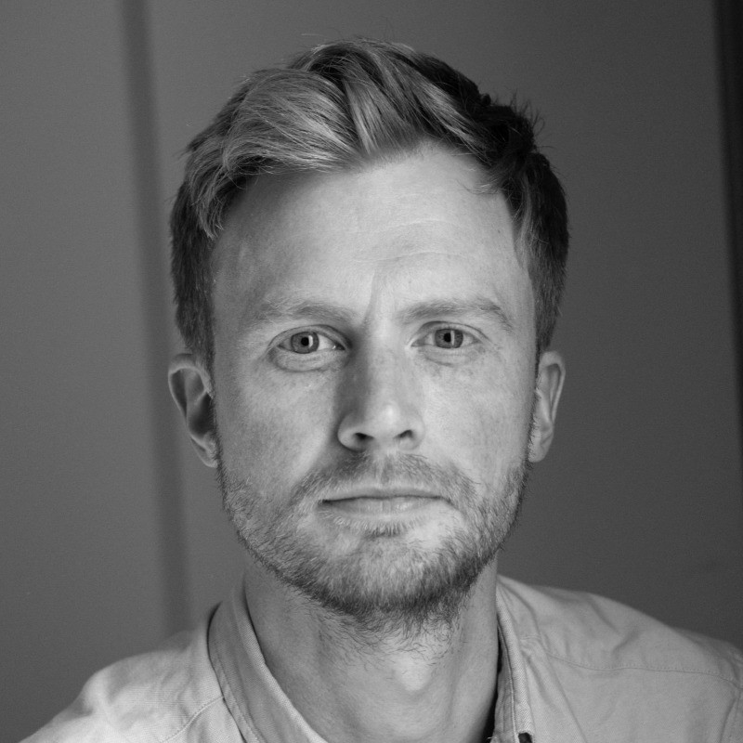
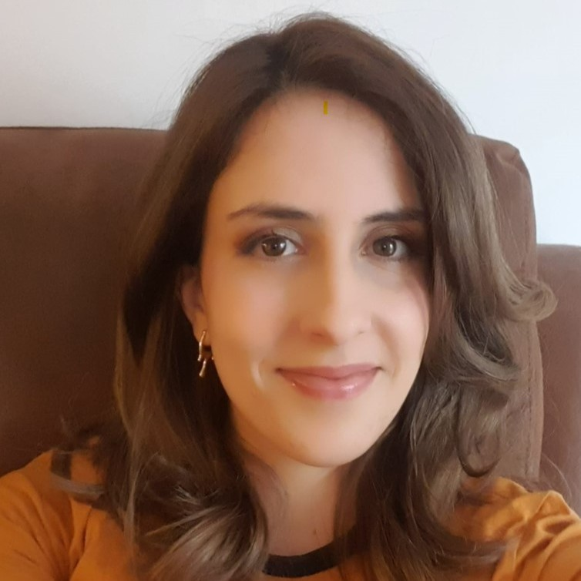
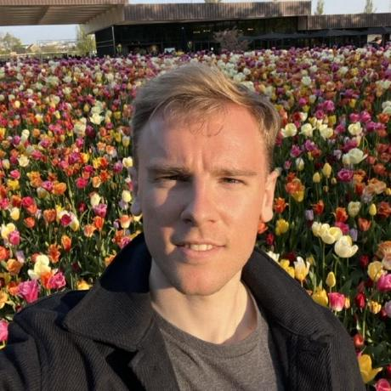
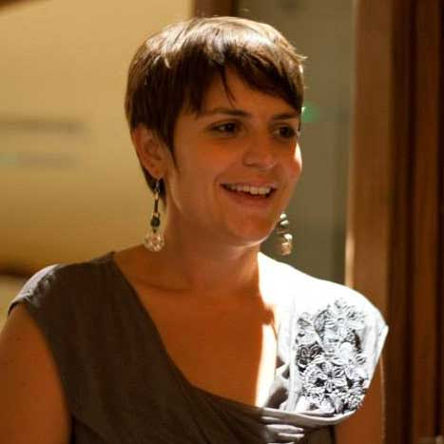
External core working group
Lisa Waddel
PHAC
Adam Kucharski
LSHTM - Epiverse
Carmen Tamayo Cuartero
LSHTM - Epiverse
Joshua Lambert
LSHTM - Epiverse
Anne Cori
Imperial College London
Notes:
I would also like to introduce and extend my thanks to the following community members who have been actively engaged from the beginning of this project and have made significant contributions in terms of workshop/hackathon organization, tool development, report drafting and informing key elements of the project.

